Slide 1
An Improved Texture Transformer Network for Ref-based Image Super-Resolution
张博宇 沈飞鸿 鲁瀚洋

Slide 2
Content
Background
Comparison
Innovation
Experiments
Codes

Slide 3


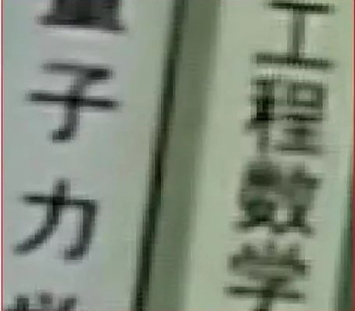
Background
How to restore these images?
Notes:
there

Slide 4
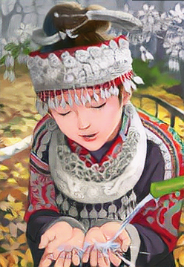
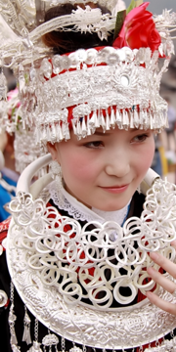


Background

Slide 5
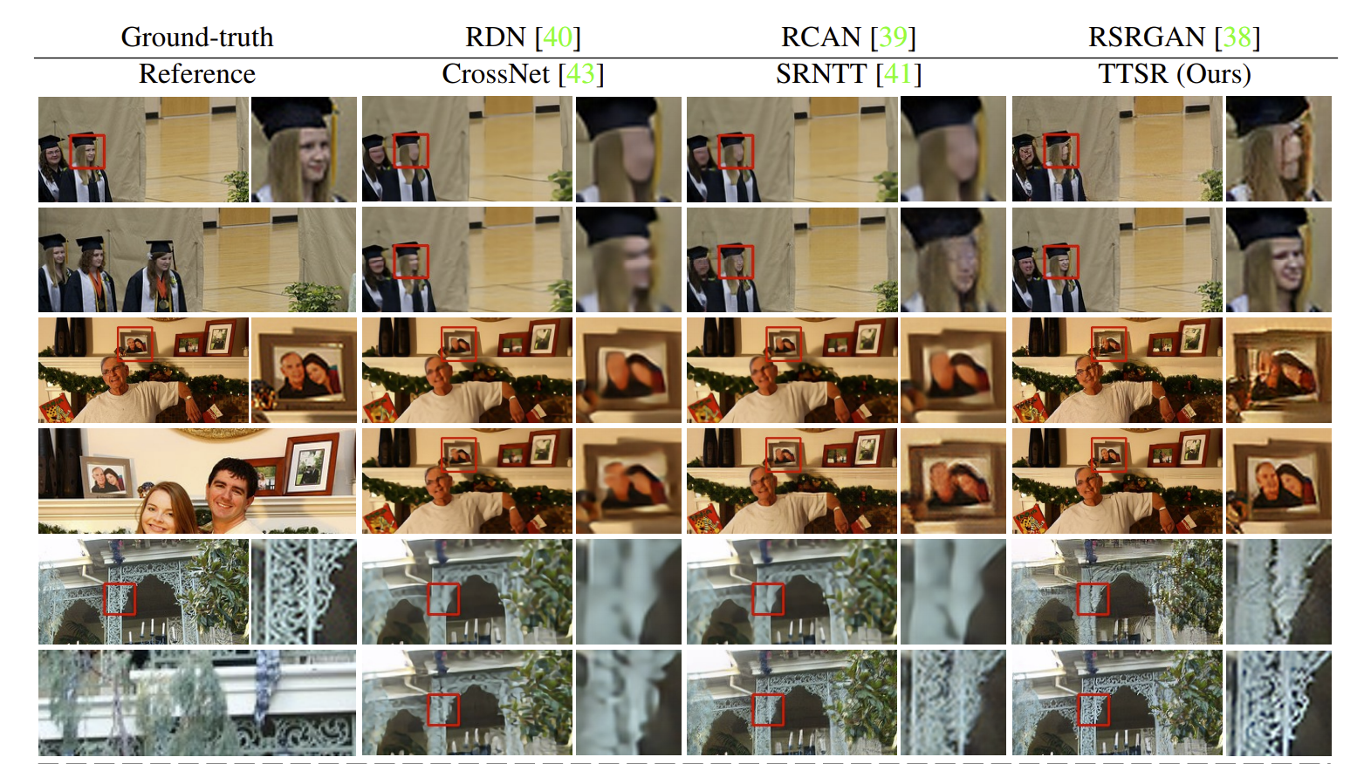
Background

Slide 6
Content
Background
Comparison
Innovation
Experiments
Codes

Slide 7
Comparison
 | DSFT | SRNTT | TTSR | OURS
PSNR
SIMI
Adaptivity
Training Spped
Testing Speed

Slide 8
Comparison

Slide 9
Content
Background
Comparison
Innovation
Experiments
Codes

Slide 10
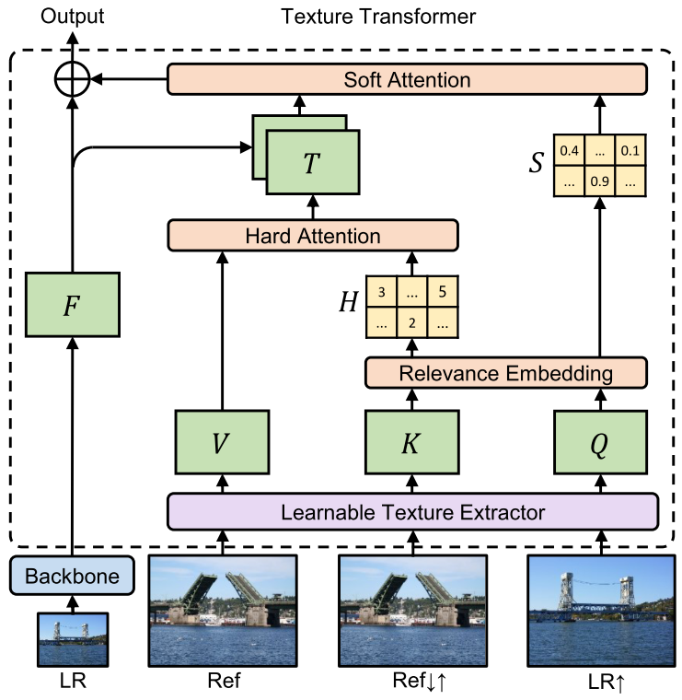
Innovation
MainNet
SearchTransfer
LTE

Slide 11
Innovation
A new adversarial loss
A New Learnable Texture Extractor
A New Auto Adaption Algorithm

Slide 12
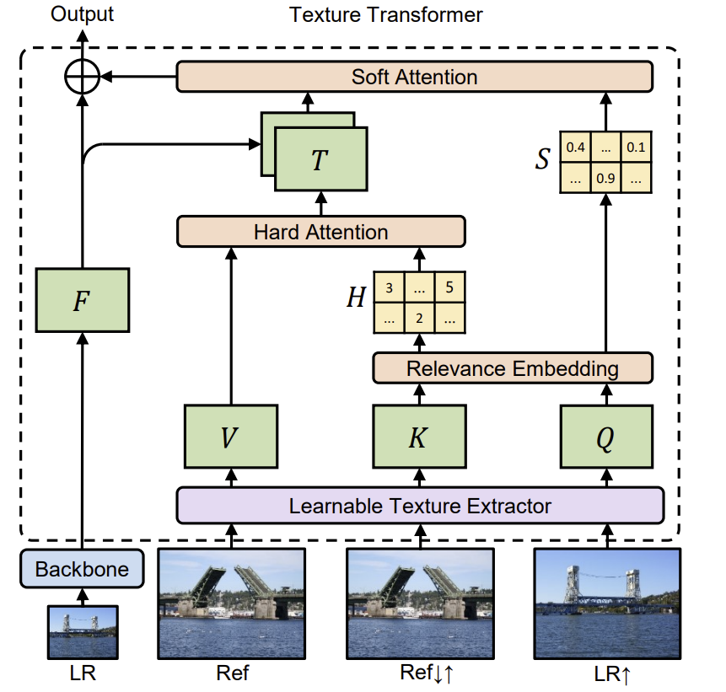
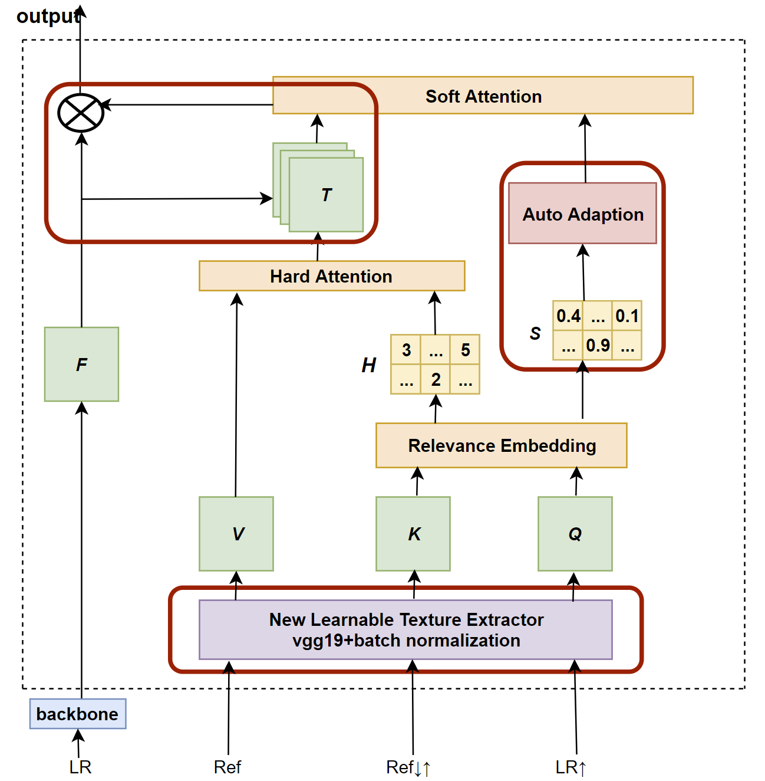
Innovation
TTSR
OURS

Slide 13
Innovation

Slide 14

Experiments
CUFED5
11871 training inputs
126 testing inputs

Slide 15
preprocessing

Slide 16
Codes
Assignment
Name | Task | Percentage
Boyu Zhang | Loss functions implementation | 10% | 35%
 | Auto adaptive algorithm implementation | 20%
 | Changing adversarial loss function | 5%
Feihong Shen | Feature extractor network implementation | 15% | 30%
 | New learnable texture extractor implementation | 15%
Hanyang Lu | Data preprocessing | 15% | 30%
 | Main network implementation | 15%
All | Configure server, debug important parameters | 5% | 5%

Slide 17
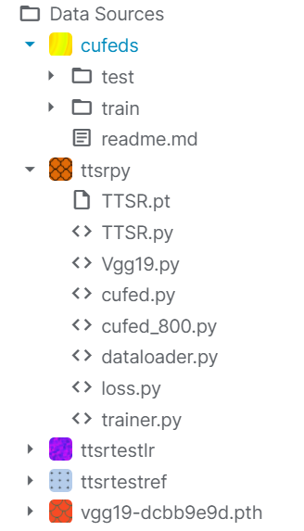
Codes
Environment deployment on Kaggle

Slide 18
Codes
Data preprocessing
Transform:
随机旋转
随机翻转
转换为Tensor
归一化

Slide 19
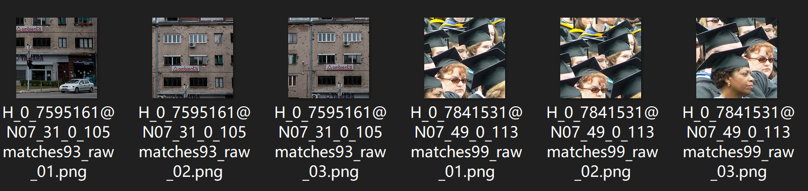
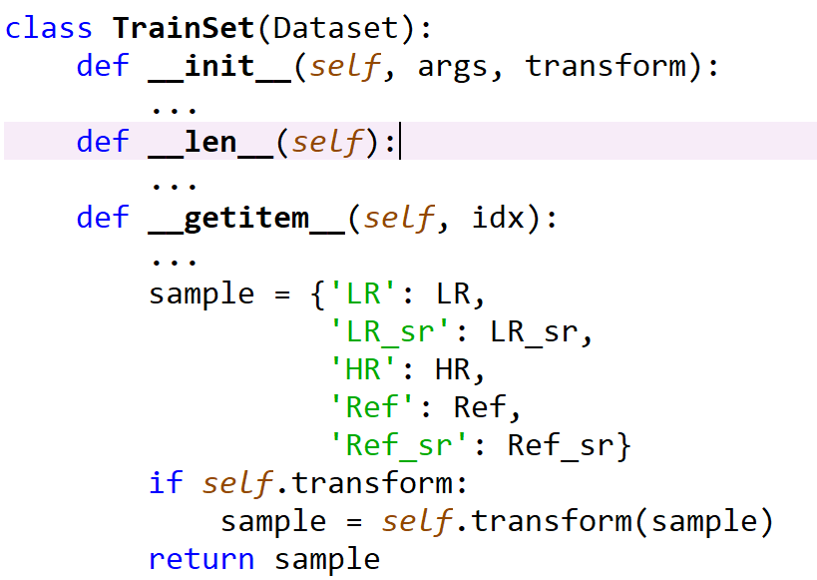
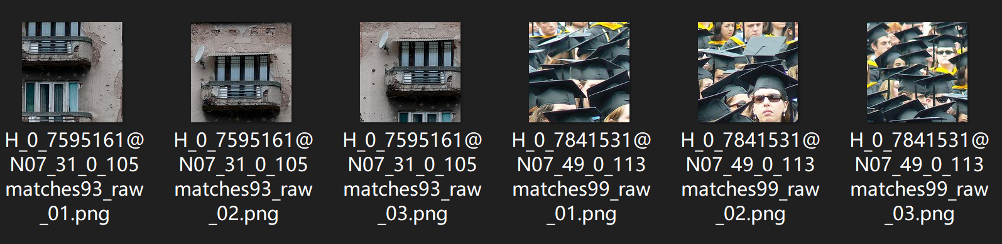
Codes
Dataset
CUFED\train\input(HR)
CUFED\train\ref(Ref)

Slide 20
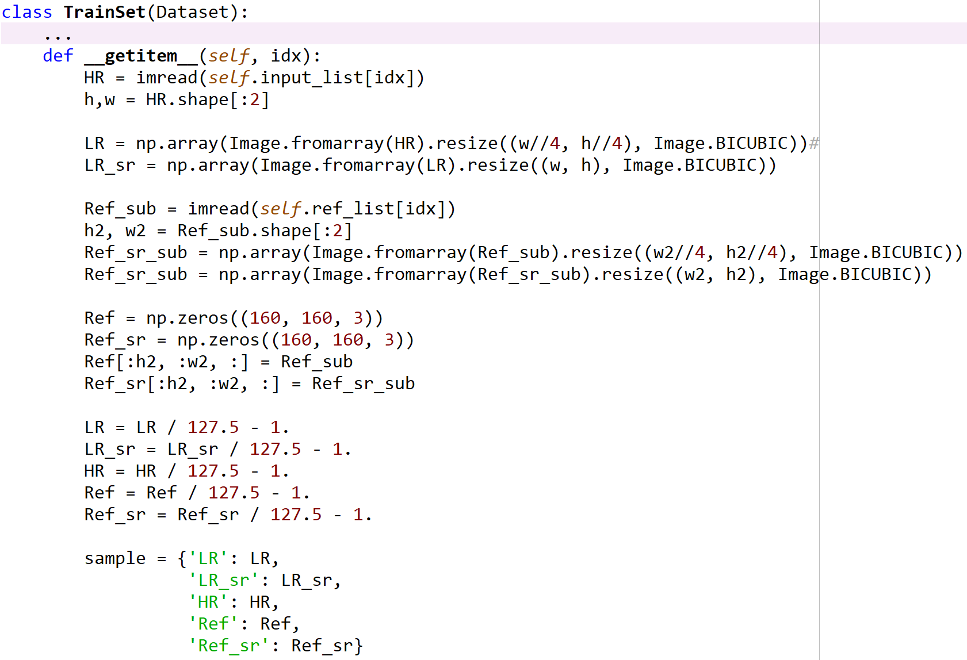
Codes
Preprocessing

Slide 21
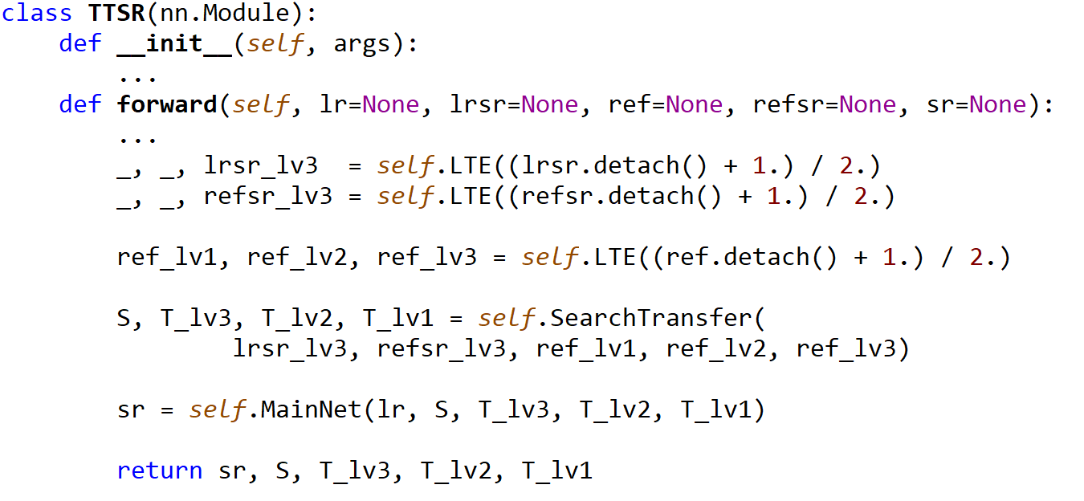
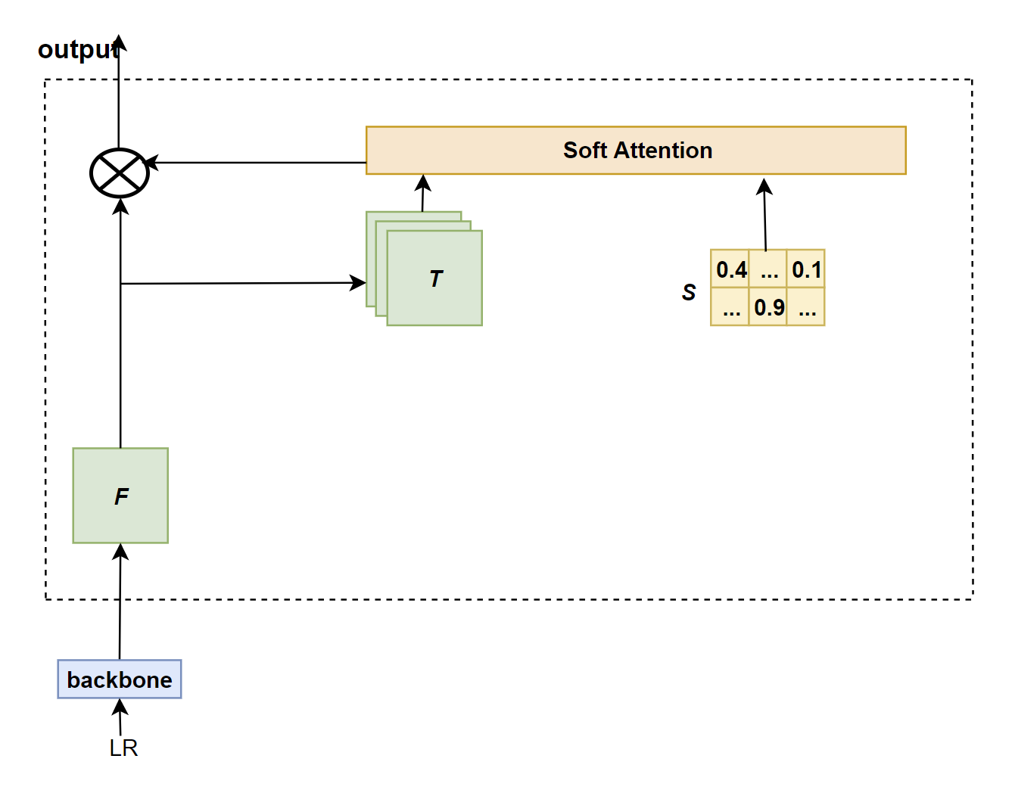
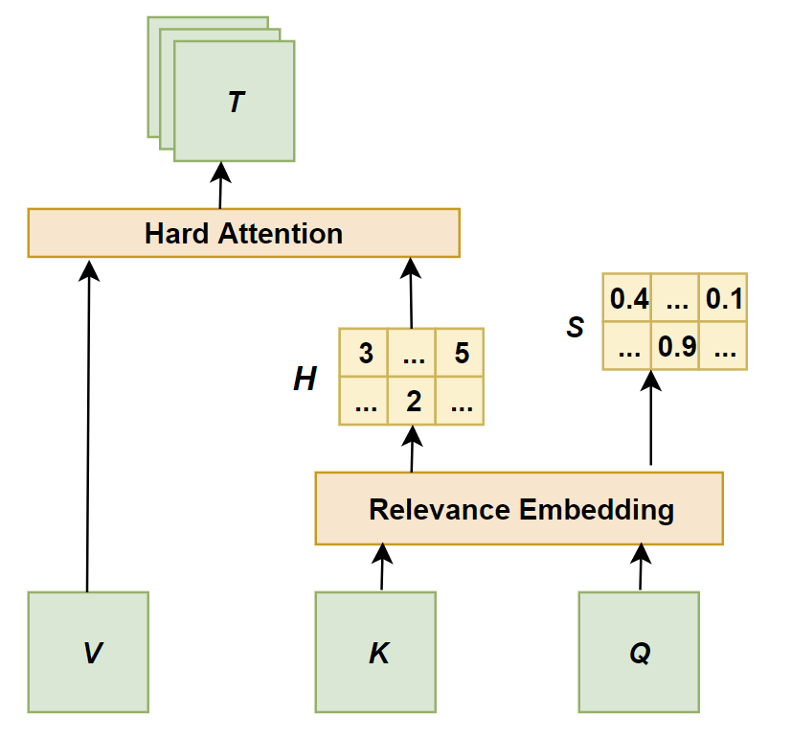
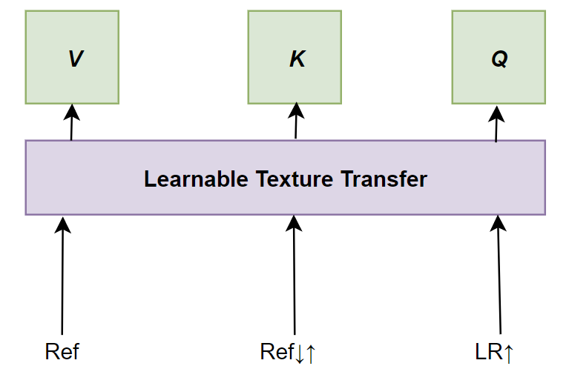
Codes
Network Structure

Slide 22
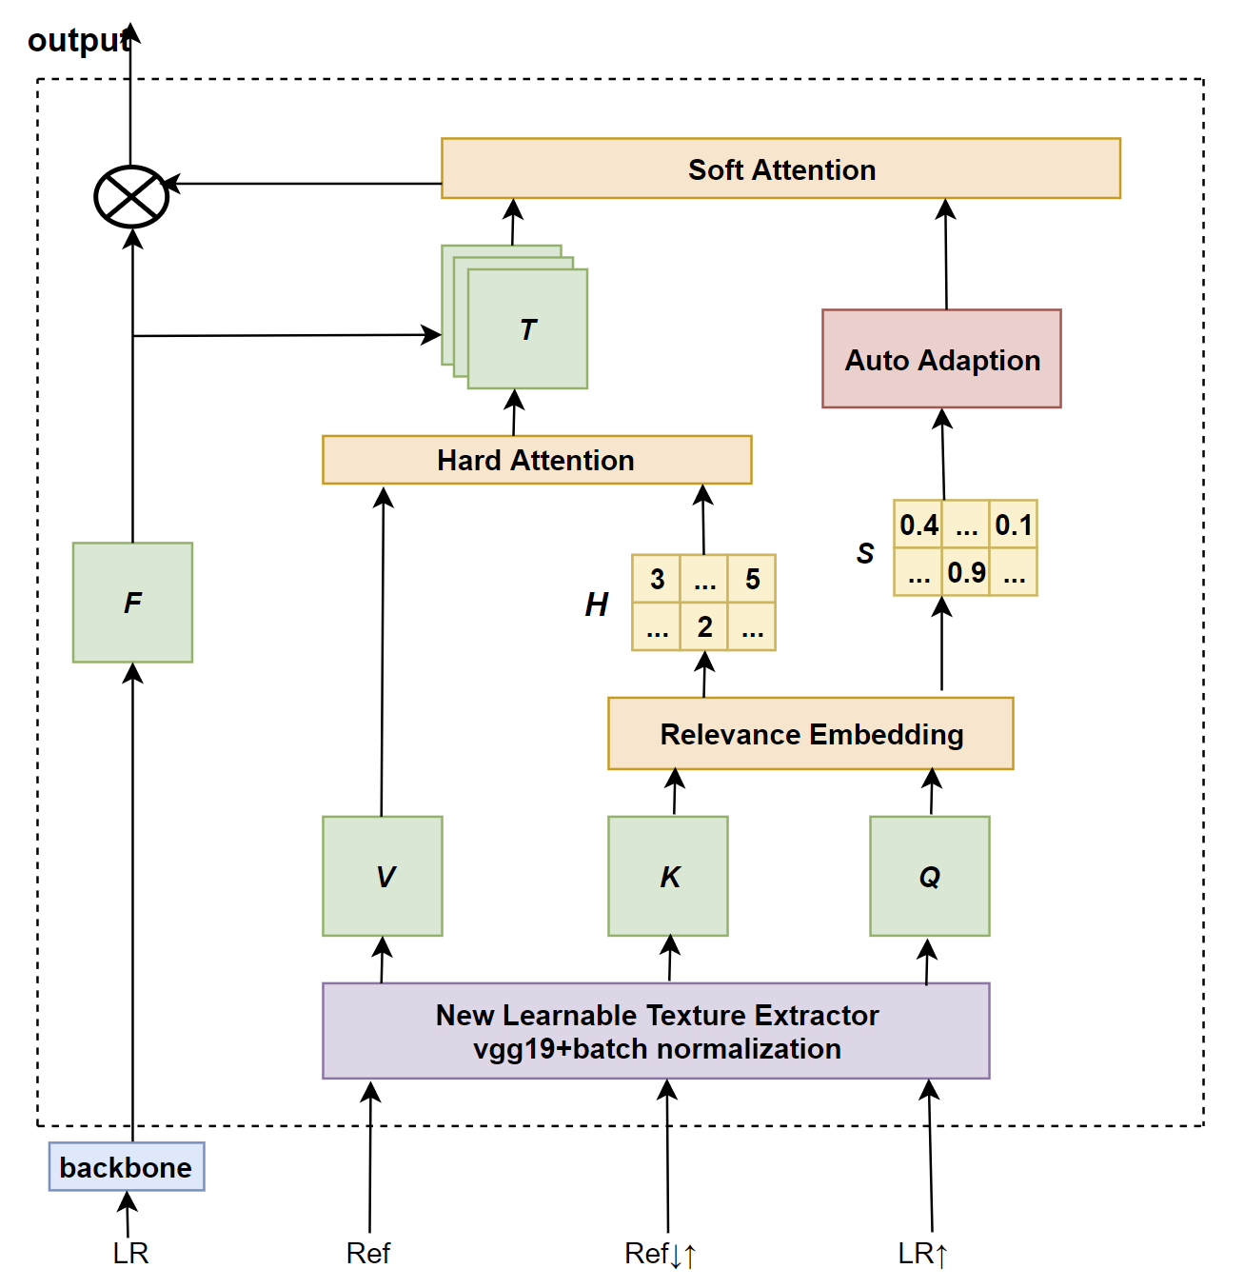
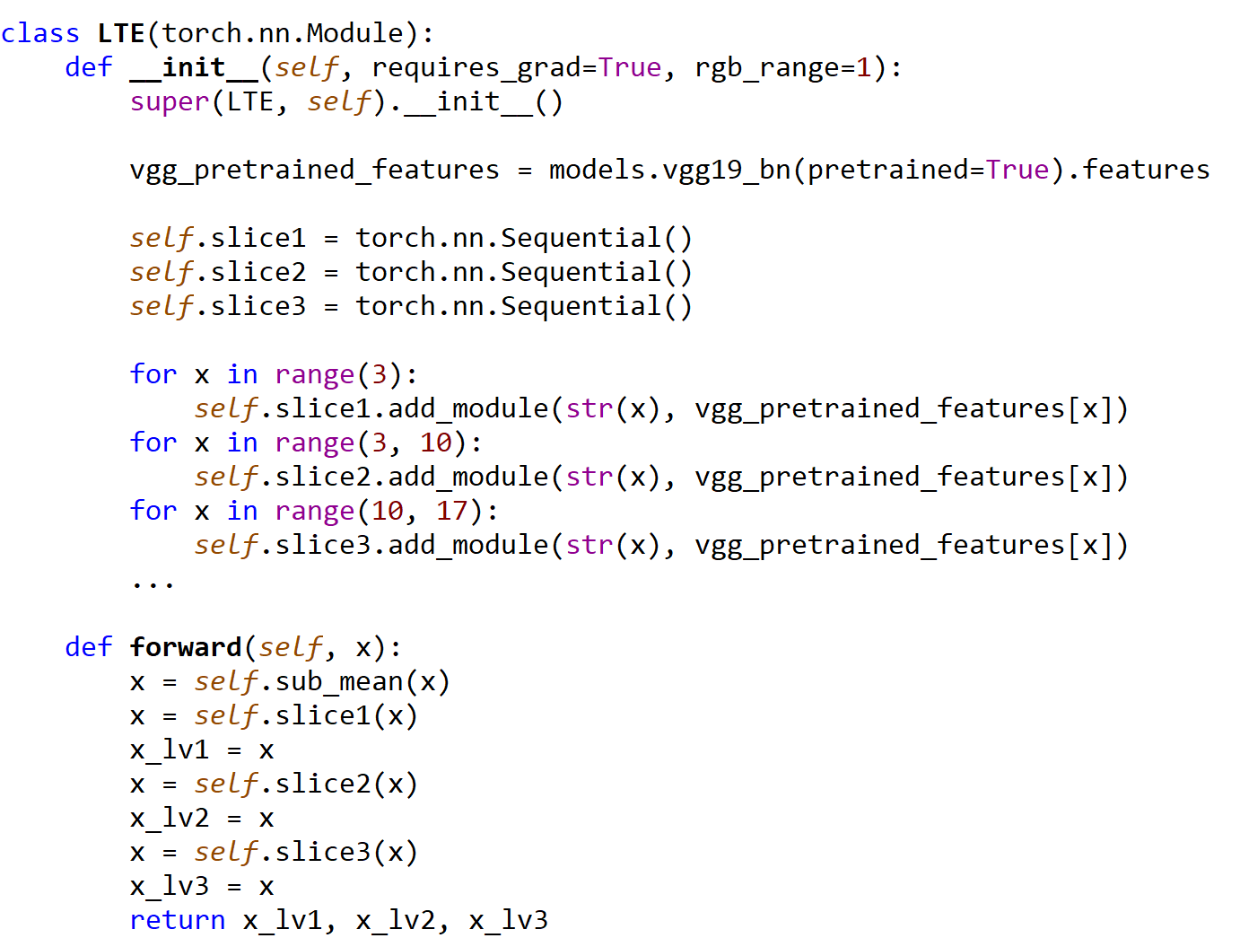
Codes
Network Structure

Slide 23
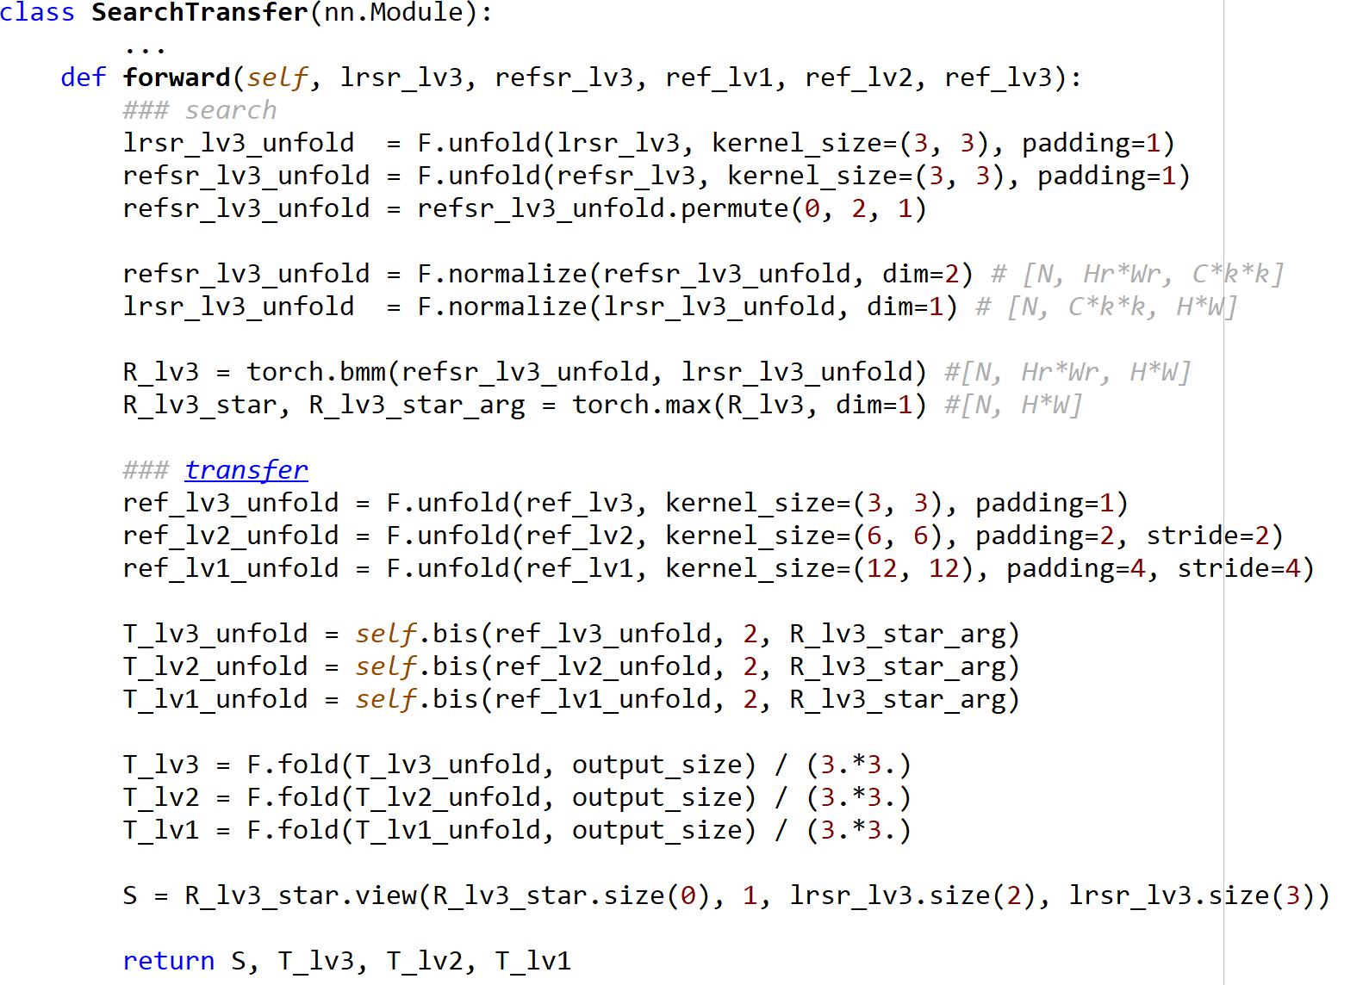
Codes
Network Structure

Slide 24
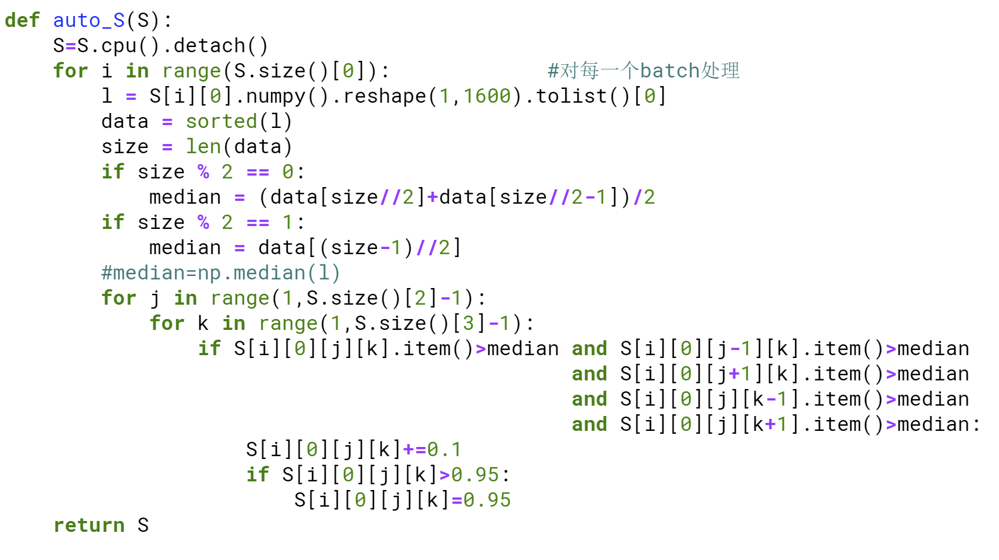
Codes
An adaptive algorithm

Slide 25
Codes
Network Structure

Slide 26
Codes

Slide 27
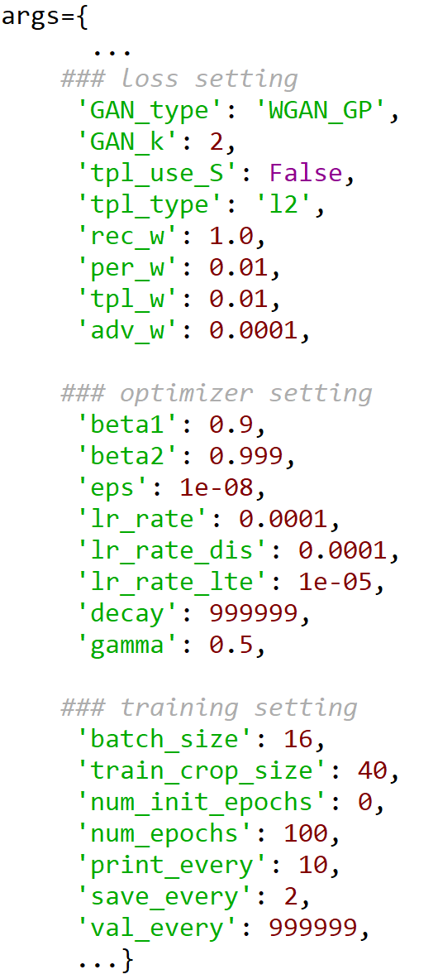
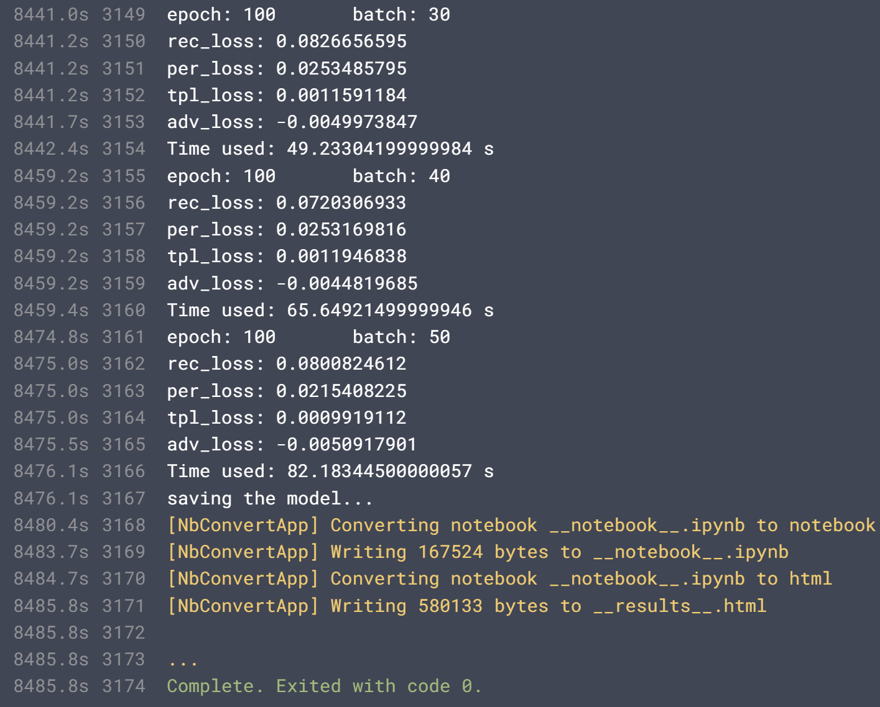
Codes
Training
A set of training parameters
Training result

Slide 28
Thanks!

